Slide 1
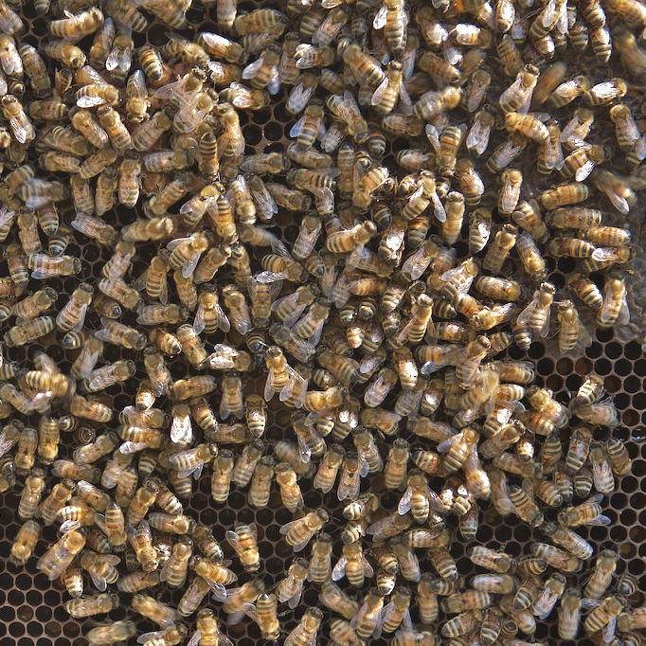
C♯ JSON and the REST
Rasmus Lystrøm
Associate Professor
ITU
This Photo by Unknown Author is licensed under CC BY-SA-NC

Slide 2

Agenda
XML
SOAP
JSON
YAML
REST
ASP.NET Core
Web API with ASP.NET Core
Testing ASP.NET Core
gRPC
GraphQL
This Photo by Unknown Author is licensed under CC BY-NC-ND

Slide 3
XML

Slide 4
XML
eXtensible Markup Language
Markup language like HTML
Designed to carry data, not to display data
Tags are not predefined – You must define your own tags
Designed to be self-descriptive

Slide 5
XML does not do anything
XML was created to structure, store, and transport information
<?xml version="1.0" encoding="UTF-8"?>
<note id="1">
<to>Kathleen B.</to>
<from>Tom W.</from>
<subject>Reminder</subject>
<body>Don't forget small change!</body>
</note>

Slide 6
How Can XML be Used?
Separates data from HTML
Simplifies data sharing
Simplifies data transport
Simplifies platform changes
Used to create new (Internet) languages
XHTML
WSDL for describing web services
RSS and ATOM for news feeds
XAML

Slide 7
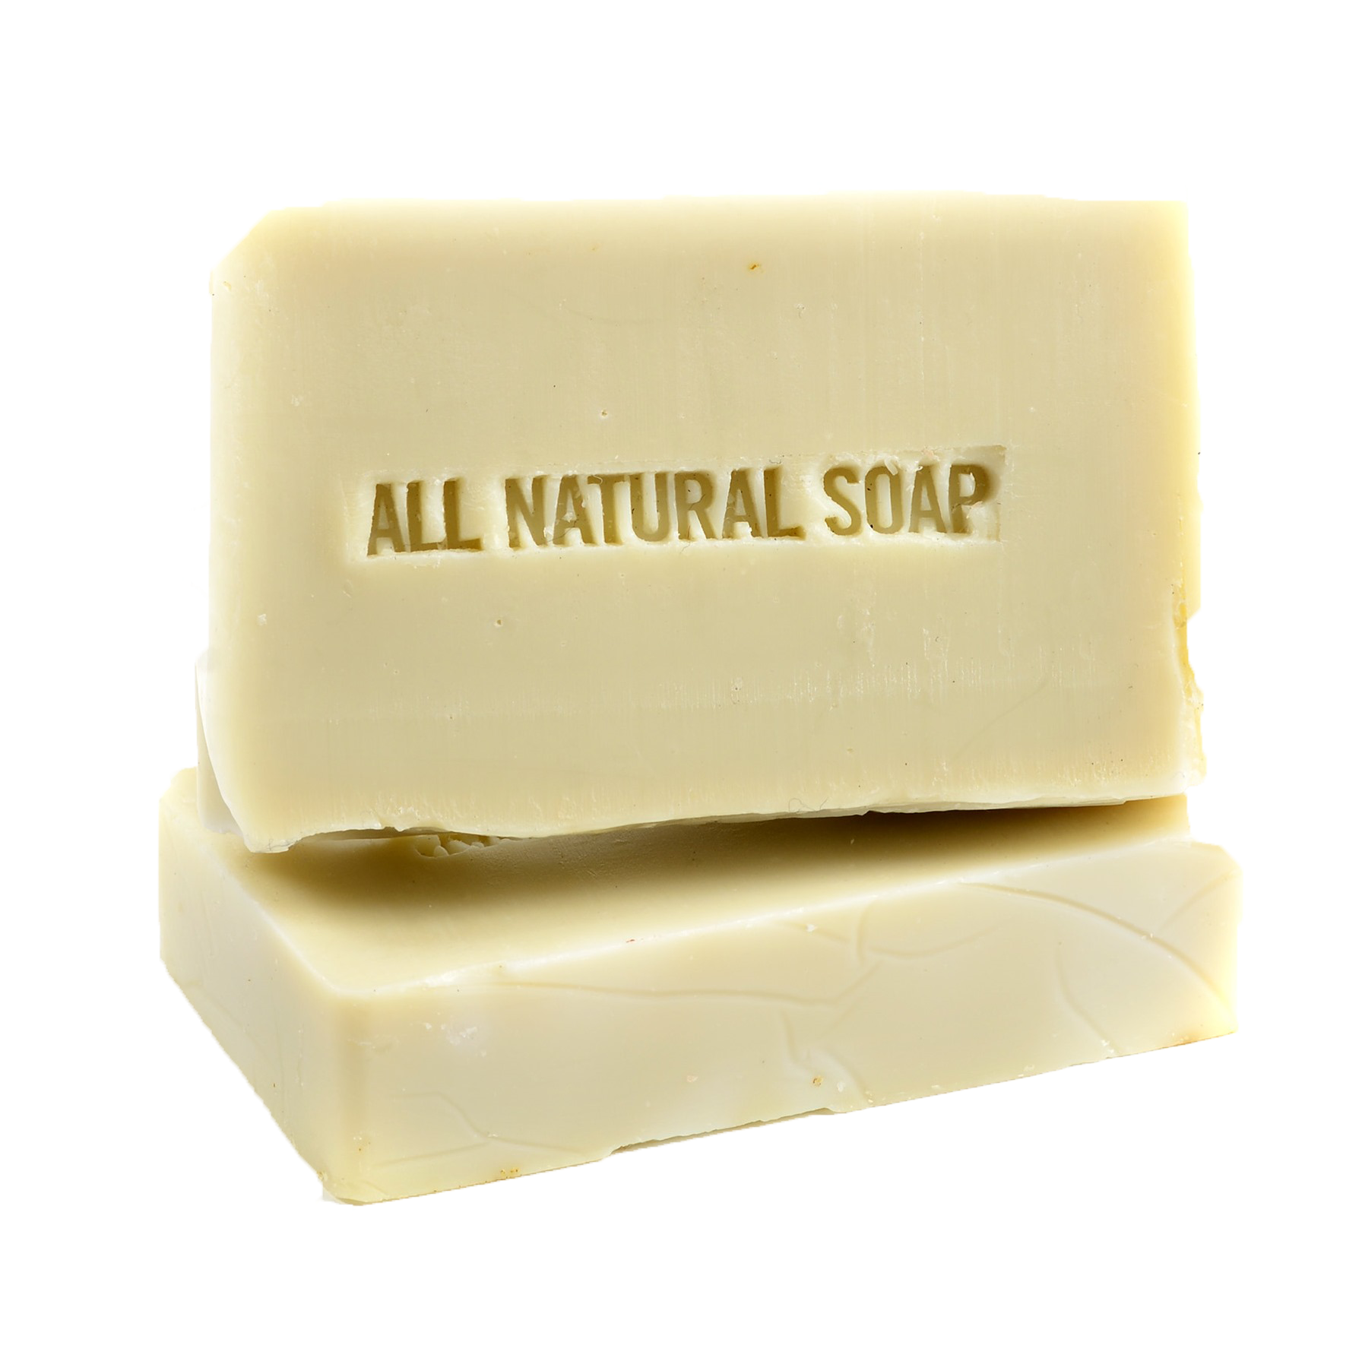
SOAP
This Photo by Unknown Author is licensed under CC BY-NC

Slide 8
SOAP request
POST https://store.com/services/PriceService/getPrice
<?xml version="1.0"?> <soap:Envelope xmlns:soap="http://www.w3.org/2003/05/soap-envelope/" soap:encodingStyle="http://www.w3.org/2003/05/soap-encoding"> <soap:Body> <m:GetPrice xmlns:m="https://www.w3schools.com/prices"> <m:Item>Apples</m:Item> </m:GetPrice> </soap:Body> </soap:Envelope>
Source: https://www.w3schools.com/xml/xml_soap.asp

Slide 9
SOAP response
<?xml version="1.0"?> <soap:Envelope xmlns:soap="http://www.w3.org/2003/05/soap-envelope/" soap:encodingStyle="http://www.w3.org/2003/05/soap-encoding"> <soap:Body> <m:GetPriceResponse xmlns:m="https://www.w3schools.com/prices"> <m:Price>1.90</m:Price> </m:GetPriceResponse> </soap:Body> </soap:Envelope>
Source: https://www.w3schools.com/xml/xml_soap.asp

Slide 10

JSON
This Photo by Unknown Author is licensed under CC BY-SA

Slide 11
JSON
JavaScript Object Notation
Lightweight text-data interchange format
Language independent (uses JavaScript syntax)
"Self-describing" and easy to understand

Slide 12
JSON Syntax
(subset of the JavaScript object notation syntax)
Data is in name/value pairs
Data is separated by commas
Curly braces hold objects
Square brackets hold arrays

Slide 13
JSON Name/Value Pairs
A name/value pair consists of a field name (in double quotes), followed by a colon, followed by a value:
"givenName": "John"
This is simple to understand, and equals to the JavaScript statement:
givenName = "John"

Slide 14
JSON Data Types
Number (integer or floating point)
String (in double quotes)
Boolean (true or false)
Array (in square brackets)
Object (in curly brackets)
null

Slide 15
Examples
{ "alterEgo": "Batman", "firstAppearance": 1939 }
[
{ "givenName": "Bruce", "surname": "Banner" },
{ "givenName": "Bruce", "surname": "Wayne" },
{ "givenName": "Bruce", "surname": "Gordon" }
]
null
"Batman"

Slide 16
Best of both worlds?
https://www.ibm.com/support/knowledgecenter/en/SS9H2Y_7.7.0/com.ibm.dp.doc/json_jsonxconversionexample.html

Slide 17

YAML
This Photo by Unknown Author is licensed under CC BY

Slide 18
YAML
YAML Ain't Markup Language
Human-readable data-serialization language.
It is commonly used for configuration files and in applications where data is being stored or transmitted.
Superset of JSON

Slide 19
YAML Example
version: '3.9'
services:
sql-server:
image: mcr.microsoft.com/mssql/server:2019-latest
hostname: sql-server
container_name: sql-server
ports:
- 1433:1433
environment:
ACCEPT_EULA: 'Y'
SA_PASSWORD_FILE: /run/secrets/sa_password
MSSQL_PID: Express
secrets:
sa_password:
file: ./local/sa_password.txt

Slide 20
REST
http://
REpresentational State Transfer

Slide 21
HTTP request
URI: string
(Query): key/value pairs
Method: string
Header: key/value pairs
Body: string/binary

Slide 22
HTTP response
Status-Code: number
Header: key/value pairs
Body: string/binary

Slide 23
REST
Maps your CRUD actions to HTTP verbs
Action | Verb
Create | POST
Read (Retrieve) | GET
Update (Replace) | PUT
Update (Modify) | PATCH
Delete | DELETE

Slide 24
HTTP status codes
Code | Meaning
200 | OK
201 | Created
202 | Accepted
204 | No Content
301 | Moved Permanently
302 | Found (Previously "Moved temporarily")
307 | Temporary Redirect
308 | Permanent Redirect
Code | Meaning
400 | Bad Request
401 | Unauthorized
403 | Forbidden
404 | Not Found
409 | Conflict
415 | Unsupported Media Type
418 | I’m a Teapot
422 | Unprocessable Entity
500 | Internal Server Error
501 | Not Implemented
503 | Service Unavailable

Slide 25
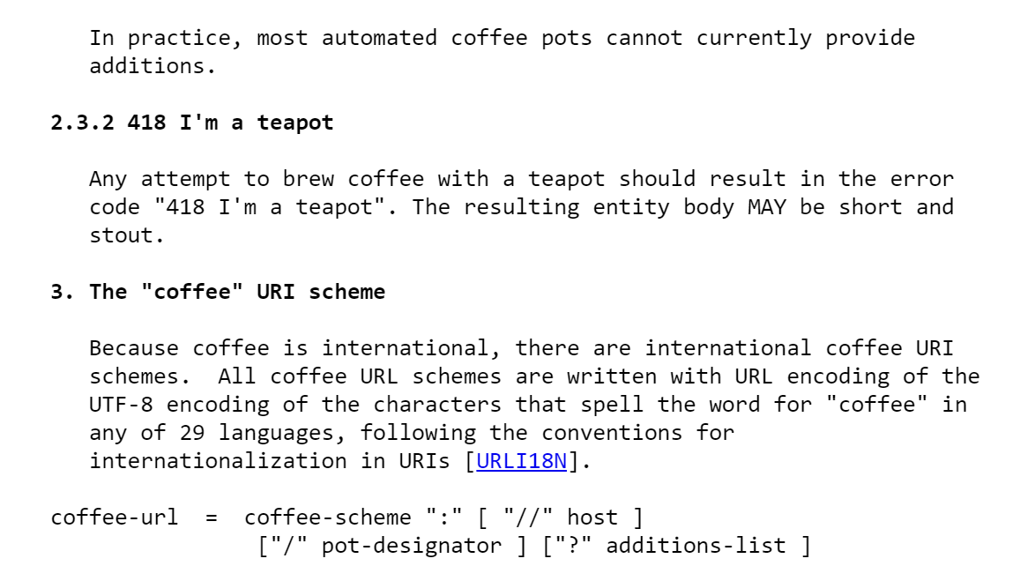
RFC2324: Hyper Text Coffee Pot Control Protocol
Source: https://tools.ietf.org/html/rfc2324

Slide 26
HTTP headers
Header Field | Description | Examples
Accept | Content-Types that are acceptable for the response | text/plain application/json application/xml
Content-Type | The media type of the body of the request (POST, PUT, and PATCH) | application/x-www-form-urlencoded application/json; charset=utf-8
Authorization | Authentication credentials for HTTP authentication | Bearer ey…

Slide 27
Why REST?
Simple, both conceptually and programmatically
Simpler and cleaner than SOAP
REST is the new black

Slide 28
REST request
GET https://store.com/prices/Apples

Slide 29
REST response
1.9

Slide 30
HTTP request
URI: https://futurama.com/api/characters
Method: POST
Header:
Content-Type: application/json; charset=utf-8
Authorization: Bearer ey...
Body:
{
"name": "Bender",
"species": "Robot",
"planet": "Earth"
}

Slide 31
HTTP response
Status-Code: 201
Header:
Content-Type: application/json; charset=utf-8
Location: https://futurama.com/api/characters/42
Body:
{
"id": 42,
"name": "Bender",
"species": "Robot",
"planet": "Earth"
}

Slide 32
ASP.NET Core

Slide 33
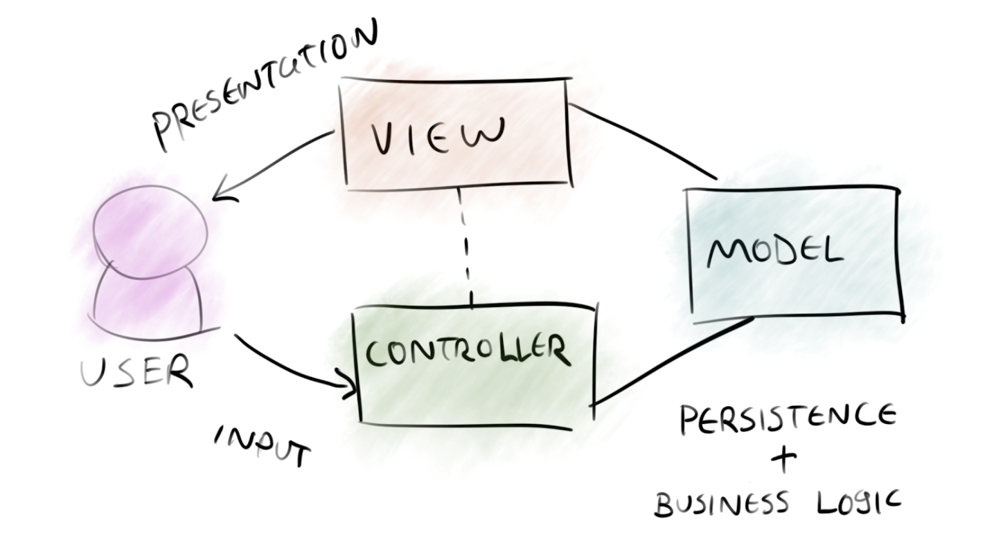
Model – View – Controller

Slide 34
ASP.NET Web API
Application

Slide 35
ASP.NET Core Web API
Demo

Slide 36
Controller
Class
Derive from ControllerBase
Decorate with [ApiController] and [Route("[controller]")]
Method
Decorate with [HttpGet], [HttpPost], [HttpPut], [HttpDelete]
Return specific type, IActionResult, or ActionResult<T> - or async Task<...>.

Slide 37
ASP.NET (Web API) best practices

Slide 38
Be RESTful
Use proper status codes
Use meaningful routes
Use proper HTTP methods
Don’t throw exceptions

Slide 39
Use user secrets in development
dotnet user-secrets init
dotnet user-secrets set "ConnectionStrings:<connectionstring-name>" "<connnection-string>"

Slide 40
Use built-in IoC container
services.AddDbContext<MyContext>(o => o.UseSqlServer(Configuration.GetConnectionString("MyConnectionStringName")) );
services.AddScoped<IMyContext, MyContext>();
services.AddScoped<IMyRepository, MyRepository>();

Slide 41
Consider running migrations on load
using (var serviceScope = app.ApplicationServices .GetRequiredService<IServiceScopeFactory>().CreateScope())
{
var context = serviceScope.ServiceProvider.GetService<SuperheroContext>();
context.Database.Migrate();
}

Slide 42
Support the OpenAPI Specification (Swagger)
dotnet add package Swashbuckle.AspNetCore
using Microsoft.OpenApi.Models;
services.AddSwaggerGen(c =>
{
c.SwaggerDoc("v1", new OpenApiInfo { Title = "My API", Version = "v1" });
});
app.UseSwagger();
app.UseSwaggerUI(c =>
{
c.SwaggerEndpoint("/swagger/v1/swagger.json", "My API V1");
c.RoutePrefix = string.Empty;
});

Slide 43
Support HTTPS only
dotnet dev-certs https --trust
app.UseHttpsRedirection();

Slide 44
Standardize on lowercase urls
services.AddRouting(options => options.LowercaseUrls = true);

Slide 45
Secure your Web API
Azure AD (later)
Azure AD B2C
3rd party
Do not write your own security layer!!!

Slide 46

Testing ASP.NET Core
This Photo by Unknown Author is licensed under CC BY-SA

Slide 47

Stub → Mock → Fake
This Photo by Unknown Author is licensed under CC BY-SA-NC

Slide 48
Stubs
public class FooServiceFalseStub : IFooService
{
public bool Bar(Foo foo)
{
return false;
}
}

Slide 49
Stubs
[Fact]
public void Exec_when_IFooService_Update_returns_false_returns_false()
{
IFooService service = new FooServiceTrueStub();
var baz = new Baz(service);
var result = baz.Exec(new Foo());
Assert.False(result);
}

Slide 50
Mocks
[Fact]
public void Exec_when_IFooService_Update_returns_false_returns_false()
{
var mock = new Mock<IFooService>();
IFooService service = mock.Object;
var baz = new Baz(service);
var result = baz.Exec(new Foo());
Assert.False(result);
}

Slide 51
Mocks
[Fact]
public void Exec_when_IFooService_Update_true_returns_true()
{
var mock = new Mock<IFooService>();
mock.Setup(m => m.Update(It.IsAny<Foo>())).Returns(true);
var baz = new Baz(mock.Object);
var result = baz.Exec(new Foo());
Assert.True(result);
}

Slide 52
Testing ASP.NET Core with Moq
Demo

Slide 53
gRPC

Slide 54
gRPC Remote Procedure Calls
gRPC is a modern, open source, high-performance remote procedure call (RPC) framework that can run anywhere. gRPC enables client and server applications to communicate transparently, and simplifies the building of connected systems.
$ dotnet new grpc
Source: https://github.com/grpc/grpc

Slide 55
GraphQL

Slide 56
GraphQL
GraphQL is a query language for APIs and a runtime for fulfilling those queries with your existing data. GraphQL provides a complete and understandable description of the data in your API, gives clients the power to ask for exactly what they need and nothing more, makes it easier to evolve APIs over time, and enables powerful developer tools.
Source: https://graphql.org/

